Slide 1

SRI ESHWAR COLLEGE OF ENGINEERING
ACADEMIC YEAR :2017-18
DEPARTMENT :CIVIL
SECTION :3rd year
DESIGN PROJECT
REVIEW :first review
DATE OF REVIEW :02.08.2017

Slide 2
PLANNING , ANALYSIS AND DESIGN OF THE PETROLEUM STORAGE TANKS
BATCH MEMBERS
CHARAN
DINESH KUMAR.T
PIRAGAVI.T
SAI KARTHEKA.M.K
GUIDE NAME
Mr.ROBINSON.J
Asst.prof /Civil dept.

Slide 3
ABSTRACT
Storage tank have been widely employed in several industries notably within the oil refineries and petrochemical industries accustomed to store completely different products with crude oil. Floating roof tank is one such storage facility that has a floating roof, which floats directly on top of the product, with no vapour area and eliminating the chance of combustible atmosphere. There are numerous industrial codes and standards offered for the fundamental demand for tank design and construction. The main objective of this project is 'HOW to design A FLOATING ROOF TANK BY USING ANSYS' and to develop the basic rules and procedures highlighting the issues in planning, analysis and design of floating roof by utilizing data that are gathered manually in and around the campus, to come up with a design that meets the demand of the institution and make it economical in all ways possible. Through the course of the design we aim to analyze, identify and rectify any issues that this design had had in the past and make this a optimized design .

Slide 4
TYPES OF STORAGE TANK
Fixed roof tanks
External floating roof tanks
Internal floating roof tanks
Domed external floating roof tanks
Horizontal tanks
Pressure tanks
Variable vapour space tanks
LNG(Liquefied Natural Gas)tanks

Slide 5
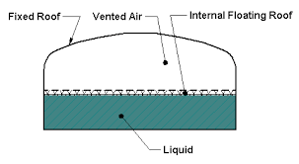
INTERNAL FLOATING ROOF TANKS
Tank has both a permanent fixed roof and floating roof inside.

Slide 6
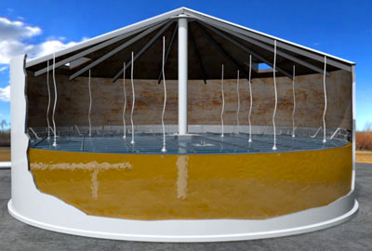
The floating roof moves up and down with the increase or decrease of the stored liquid
Floating roof are made of light weight materials such as aluminium and stainless steel

Slide 7
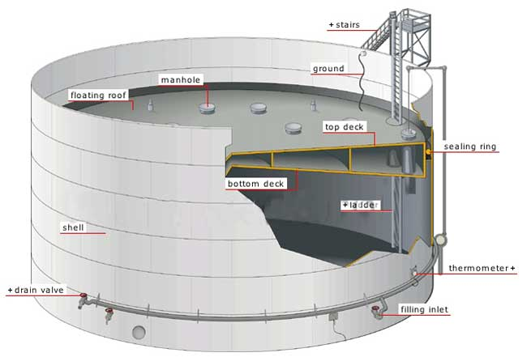

Slide 8
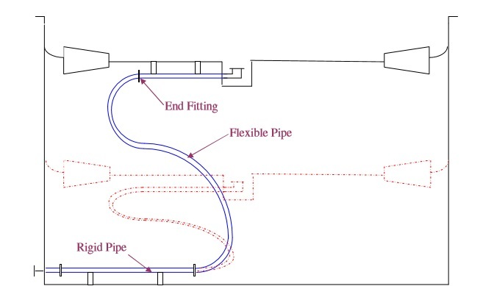
FLEXIBLE DRAIN PIPE SYSTEM

Slide 9
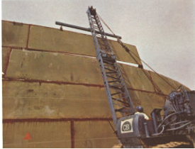
Erection of Upper Shell Course – Outside Tank

Slide 10
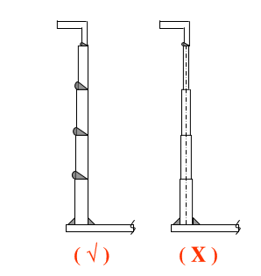
Alignment of Shell Plate for Welding

Slide 11
CODE BOOKS REFERENCE
American Standards API 650 (Welded Steel Tanks for Oil Storage)
British Standards BS 2654 (Manufacture of Vertical Storage Tanks with Butt welded Shells for the Petroleum Industry)
The European Standards
- German Code Din 4119 – Part 1 and 2 (Above Ground Cylindrical Flat Bottomed Storage Tanks of Metallic Materials)
The EEMUA Standards (The Engineering Equipments and Materials Users Association)
Company standards such as shell (DEP) and Petronas (PTS)

Slide 12
LITERATURE REVIEW
JOURNAL | Applied Energy 108 (2013)
TITLE | Experimental and simulated thermal stratification evaluation of an oil storage tank subjected to heat losses during charging
AUTHOR | Ashmore Mawire Department of Physics and Electronics, North West University (Mafikeng Campus), Private Bag X2046, Mmabatho 2735, South Africa
INFERENCE | The effect of the temperature and the heat loss factor on the thermal gradient of the storage tank is investigated. Lower temperature s and lower heat loss factors are found to increase the thermal gradient of the storage tank during the period when thermal stratification is increasing.

Slide 13
JOURNAL | American Journal of Civil Engineering and Architecture, 2013, Vol. 1, No. 6, 181-199
TITLE | Investigation of Oil Reservoir Vibration under the Impact of Earthquake in Proper and Corrosion-Occurred Tanks
AUTHOR | Afshin Mansouri1, 1Department of Civil Engineering, Master of civil Engineering, The University of Roudehen Branch, Tehran, Iran
INFERENCE | First Modal and Harmonic analyses are used to evaluate the natural frequency .These models are compared with the current experimental formulas. Next by applying corrosion on one of the tanks, dynamic features are evaluated using the software. Based on the results we found that corrosion or long term erosion have remarkable influences on natural frequency, mode-shapes of structures and its vibration.

Slide 14
JOURNAL | International Journal of Structural Engineering · January 2014
TITLE | Optimal finite element modelling for modal analysis of liquid storage circular tanks
AUTHOR | Bilal El-Ariss Civil and Environmental Engineering Department, United Arab Emirates University
INFERENCE | The objective of this study is to provide optimal FEM options of parameters such as element types and number of elements which best predict the tank dynamic characteristics, natural frequencies and principal mode shapes.

Slide 15
JOURNAL | The Open Petroleum Engineering Journal, 2016
TITLE | Experimental Study on the Explosion of Gasoline-air Mixture in Reduced-scale Storage Tank
AUTHOR | Sheng Qi, Department of Petroleum Supply Engineering, Logistical Engineering University
INFERENCE | This paper established a reduced-scale storage tank experimental system, and then the explosion characteristics of gasoline-air mixture in storage tank were studied. The ignition of gasoline-air mixture with the concentration of 2.0% HC is impossible when the concentration of O2 is below 18.80%.

Slide 16
JOURNAL | World Academy of Science, Engineering and Technology International Journal of Electrical, Computer, Energetic, Electronic and Communication Engineering Vol:11, No:3, 2017
TITLE | Protection of Floating Roof Petroleum Storage Tanks against Lightning Strokes
AUTHOR | F. M. Mohamed, A. Y. Abdelaziz
INFERENCE | Floating roof tanks (FRT’s) are especially vulnerable to lightning. This paper was inspired by a stroke of lightning that ignited a fire in a crude oil storage tank belonging to an Egyptian oil company, and is aimed at providing an efficient lightning protection system to the tank under study, in order to avoid the occurrence of such phenomena in the future and also, to give valuable recommendations to be applied to floating roof tank projects.

Slide 17
JOURNAL | Journal of Petroleum & Environmental Biotechnology
TITLE | Effect of Rim Seal on Evaporation Loss in Storage Tanks
AUTHOR | Amin Nabati, The Faculty of Mechanical Engineering, Shah rood University of Technology, Shah rood, Iran
INFERENCE | The aim of the present work is to determine the evaporation rates from external floating storage tanks and to study the effects of rim seal type on the losses. In this study, a numerical scheme has been developed for estimating the time variations of the storage tank temperature and evaporative losses.

Slide 18
JOURNAL | EARTHQUAKE ENGINEERING AND STRUCTURAL DYNAMICS Earthquake Engng Struct. Dyn. (2009)
TITLE | Experimental investigation on the seismic response of a steel liquid storage tank equipped with ﬂoating roof by shaking table tests
AUTHOR | M. De Angelis1, R. Giannini2 and F. Paolacci2,∗,† 1Department of Structural and Geotechnical Engineering, University of Rome ‘La Sapienza’, Italy
INFERENCE | In the experimental campaign the ﬂoating roof has also been taken into account. The tests have been performed on the physical model both in ﬁxed and isolated base conﬁgurations; in particular two alternative base isolation systems have been used: high-damping rubber bearings devices and sliding isolators with elasto-plastic dampers.

Slide 19
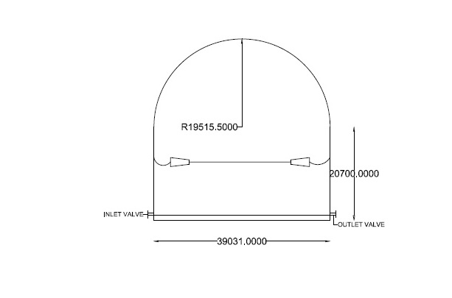
CROSS SECTIONAL VIEW

Slide 20
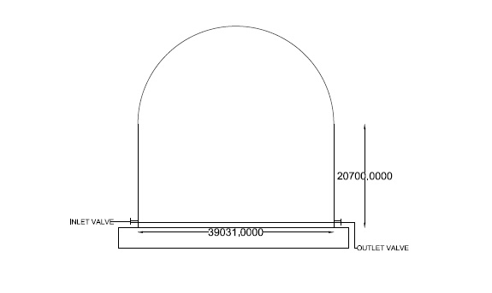
ELEVATION

Slide 21
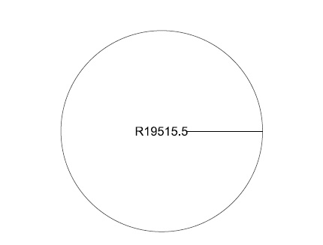
TOP VIEW

Slide 22
WORK SCHEDULE
DATE | REVIEW | WORK TO BE DONE
07-07-2017 | Re-Zeroth | Title confirmation
02-08-2017 | First | Plan
19-08-2017 | Second | Analysis and Design
18-09-2017 | Third | Design of project in ANSYS
28-09-2017 | Submission | Book submission

Slide 23
QUERIES..??

